Slide 1
Distributed Computing Introduction
Dr. Barsha Mitra
CSIS Dept, BITS Pilani, Hyderabad Campus
1

Slide 2
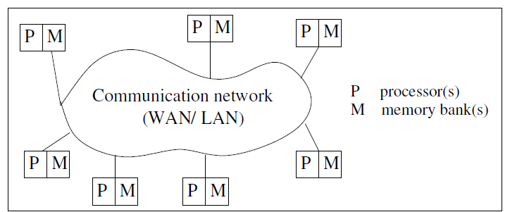
Definition of Distributed Systems
Collection of independent entities cooperating to collectively solve a task
Autonomous processors communicating over a communication network
Course ID: SS ZG526, Title: Distributed Computing
2

Slide 3
Features of Distributed System
No common physical clock
No shared memory - Requires message passing for communication
Geographical seperation
Processors are geographically wide apart
Processors may reside on a WAN or LAN
Autonomy and Heterogeneity
Loosely coupled processors
Different processor speeds and operating systems
Processors are not part of a dedicated system
Cooperate with one another
May offer services or solve a problem jointly
Course ID: SS ZG526, Title: Distributed Computing
3

Slide 4
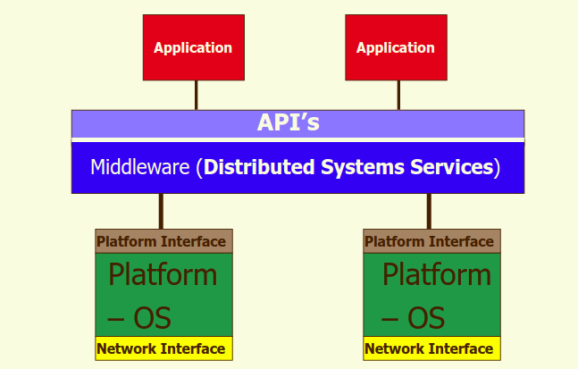
Middleware
Middleware –
distributed software
drives the distributed system
provides transparency of heterogeneity at platform level
Middleware standards:
Common Object Request Broker Architecture (CORBA)
Remote Procedure Call (RPC) mechanism
Distributed Component Object Model (DCOM)
Remote Method Invocation (RMI)
Course ID: SS ZG526, Title: Distributed Computing
4

Slide 5
Motivation for Distributed System
Inherently distributed computation
Resource sharing
Access to remote resources
Increased performance/cost ratio
Reliability
Scalability
Modularity and Incremental Expandability
Course ID: SS ZG526, Title: Distributed Computing
5

Slide 6
Coupling
Interdependency/binding and/or homogeneity among modules, whether hardware or software (e.g., OS, middleware)
High coupling → tightly coupled modules
Low coupling → loosely coupled modules
Course ID: SS ZG526, Title: Distributed Computing

Slide 7
Parallel Systems
Multiprocessor systems
E.g., Omega, Butterfly Networks
Multicomputer parallel systems
E.g., NYU Ultracomputer, CM* Connection Machine, IBM Blue gene
Array processors (collocated, tightly coupled, common system clock, may not have shared memory)
E.g., DSP applications, image processing
Course ID: SS ZG526, Title: Distributed Computing
7

Slide 8
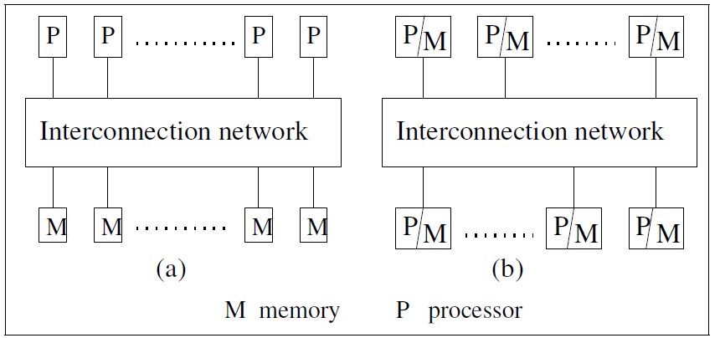
UMA Model
Direct access to shared memory
Access latency - waiting time to complete an access to any memory location from any processor
Access latency is same for all processors
Processors
Remain in close proximity
Connected by an interconnection network
Course ID: SS ZG526, Title: Distributed Computing
8

Slide 9
UMA Model
Interprocess communication occurs through read and write operations on shared memory
Processors are of same type
Remain within same physical box/container
Processors run the same operating system
Hardware & software are very tightly coupled
Interconnection network to access memory may be
Bus
Multistage switch
Course ID: SS ZG526, Title: Distributed Computing
9

Slide 10
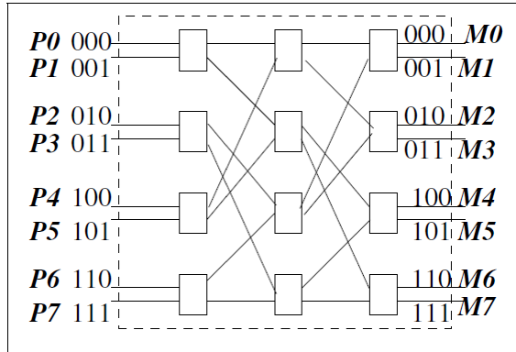
Omega Network
Multi-stage networks formed by 2 x 2 switching elements
Data can be sent on any one of the input wires
n-input and n-output network uses:
log₂(n) stages
log₂(n) bits for addressing
n processors, n memory banks
Course ID: SS ZG526, Title: Distributed Computing
10

Slide 11
Omega Network
(n/2)log₂(n) switching elements of size 2x2
Interconnection function: Output i of a stage is connected to input j of next stage:
j = 2i, for 0 ≤ i ≤ n/2 – 1
= 2i + 1 – n, for n/2 ≤ i ≤ n – 1
left-rotation operation on the binary representation of i to get j
Course ID: SS ZG526, Title: Distributed Computing
11

Slide 12
Omega Network
Routing function: from input line i to output line j
considers j and stage number s, s ϵ [0, log₂(n) – 1]
in a stage s switch
if (s + 1)^{th} MSB of j is 0, then route on upper wire
else [i.e., (s + 1)^{th} MSB of j is 1], route on lower wire
Course ID: SS ZG526, Title: Distributed Computing
12

Slide 13
Multicomputer Parallel Systems
multiple processors do not have direct access to shared memory
usually do not have a common clock
processors are in close physical proximity
very tightly coupled (homogenous hardware and software)
connected by an interconnection network
communicate either via a common address space or via message-passing
Course ID: SS ZG526, Title: Distributed Computing
13

Slide 14
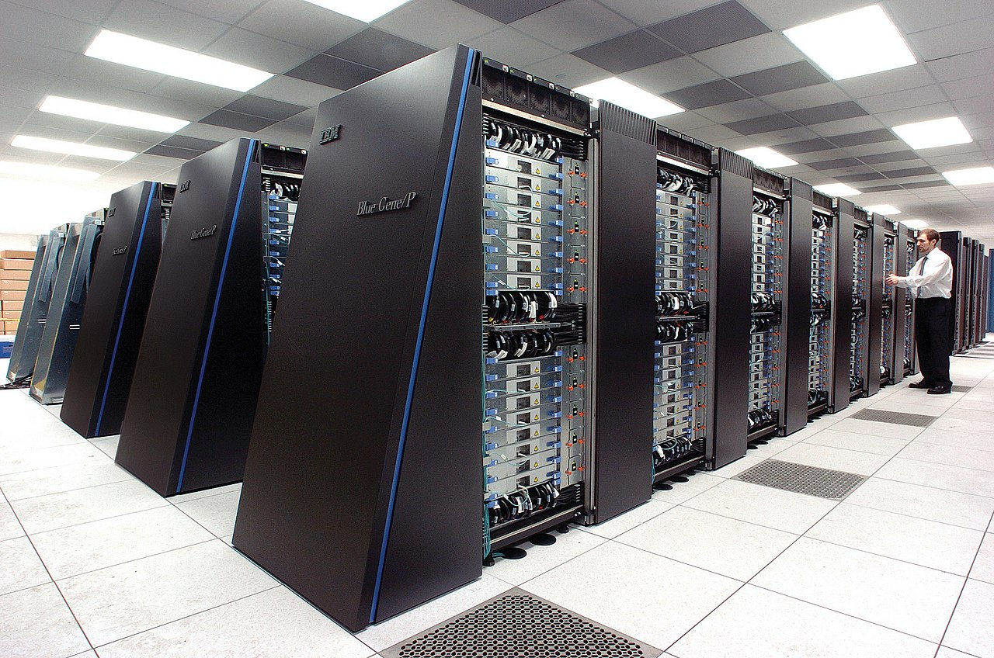
https://en.wikipedia.org/wiki/Parallel_computing#/media/File:IBM_Blue_Gene_P_supercomputer.jpg
Course ID: SS ZG526, Title: Distributed Computing
14

Slide 15
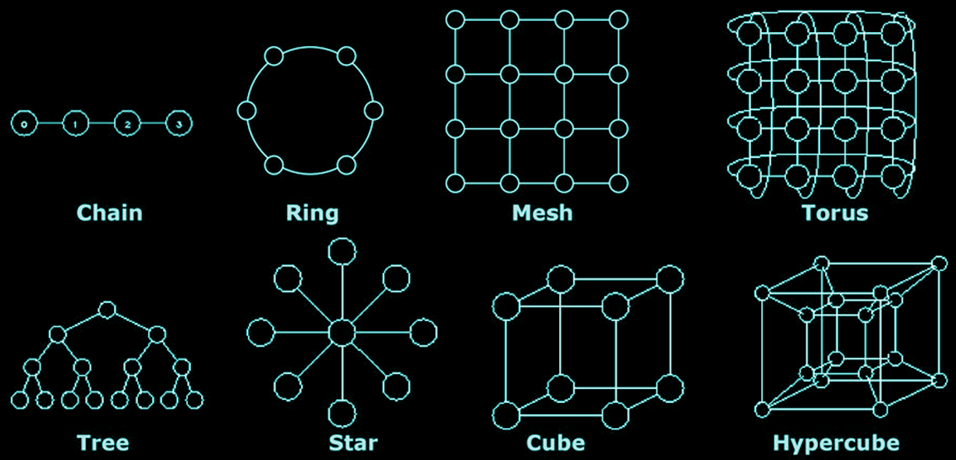
https://www.cs.iusb.edu/~danav/teach/b424/b424_24_networks.html
NUMA Model
non-uniform memory access architecture
multicomputer system having a common address space
latency to access various shared memory locations from the different processors varies
Course ID: SS ZG526, Title: Distributed Computing
15

Slide 16
Multicomputer Parallel Systems
2-D wraparound mesh
k x k mesh contains k² processors
processor + memory
Course ID: SS ZG526, Title: Distributed Computing

Slide 17
Multicomputer Parallel Systems
k-dimensional hypercube has 2^{k} processor-and-memory units (nodes)
each dimension is associated with a bit position in the label
labels of two adjacent nodes differ in the k^{th} bit position for dimension k
shortest path between any two processors → Hamming distance
Hamming distance <= k
processor + memory
Course ID: SS ZG526, Title: Distributed Computing

Slide 18
Multicomputer Parallel Systems
routing in the hypercube is done hop-by-hop
multiple routes exist between any pair of nodes → provides fault tolerance and congestion control mechanism
Course ID: SS ZG526, Title: Distributed Computing

Slide 19
Parallelism/Speedup
measure of the relative speedup of a specific program on a given machine
depends on
number of processors
mapping of the code to the processors
speedup = T(1)/T(n)
T(1) = time with a single processor
T(n) = time with n processors
Course ID: SS ZG526, Title: Distributed Computing

Slide 20
Parallel/Distributed Program Concurrency
non-communication and non-shared memory access
includes the communication or shared memory access operations
Course ID: SS ZG526, Title: Distributed Computing

Slide 21
Distributed Communication Models
Remote Procedure Call (RPC)
Publish/Subscribe Model
Course ID: SS ZG526, Title: Distributed Computing

Slide 22
RPC
Called procedure code may reside on a remote machine
make remote procedure call appear like local procedure call
goal is to hide the details of the network communication (namely, the sending and receiving of messages)
calling procedure should not be aware that the called procedure is executing on a different machine
Source: http://web.cs.wpi.edu/~rek/DCS/D04/Communication.pdf
Course ID: SS ZG526, Title: Distributed Computing
22

Slide 23
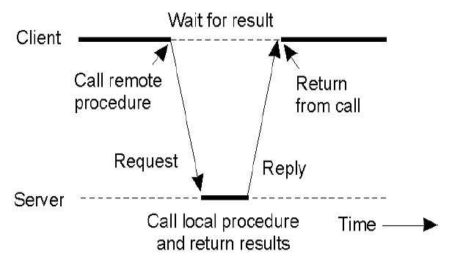
RPC between Client & Server
The client procedure calls a client stub for passing parameters
The client stub marshals the parameters, builds the message, and calls the local OS
The client's OS sends the message to the remote OS
The server’s remote OS gives message to a server stub
The server stub demarshals the parameters and calls the desired server routine
Source: http://web.cs.wpi.edu/~rek/DCS/D04/Communication.pdf
Course ID: SS ZG526, Title: Distributed Computing

Slide 24
RPC between Client & Server
The server routine does work and returns result to the server stub
The server stub marshals the return values into the message and calls local OS
The server OS sends the message to the client's OS
The client's OS gives the message to the client stub
The client stub demarshals the result, and execution returns to the client
Source: http://web.cs.wpi.edu/~rek/DCS/D04/Communication.pdf
Course ID: SS ZG526, Title: Distributed Computing

Slide 25
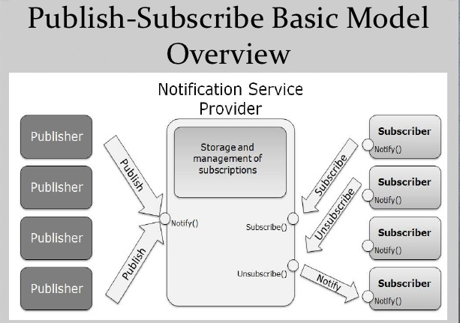
Publish/ Subscribe Model
allows any number of publishers to communicate with any number of subscribers asynchronously
form of multicasting
events are produced by publishers
interested subscribers are notified when the events are available
information is provided as notifications
subscribers continue their tasks until they receive notifications
Course ID: SS ZG526, Title: Distributed Computing

Slide 26
References
Ajay D. Kshemkalyani, and Mukesh Singhal, Chapter 1, “Distributed Computing: Principles, Algorithms, and Systems”, Cambridge University Press, 2008.
https://medium.com/@rashmishehana_48965/middleware-technologies-e5def95da4e
http://wiki.c2.com/?PublishSubscribeModel
https://www.slideshare.net/ishraqabd/publish-subscribe-model-overview-13368808/5
Course ID: SS ZG526, Title: Distributed Computing
26

Slide 27
Thank You
Course ID: SS ZG526, Title: Distributed Computing
27

Slide 28
Distributed Computing Logical Time
Dr. Barsha Mitra
CSIS Dept, BITS Pilani, Hyderabad Campus

Slide 29
Introduction
not possible to have global physical time
realize only an approximation of physical time using logical time
logical time advances in jumps
captures monotonicity property
monotonicity property: if event a causally affects event b, then timestamp of a is smaller than timestamp of b
Ways to represent logical time:
scalar time
vector time
Course ID: SS ZG526, Title: Distributed Computing

Slide 30
Logical Clocks
every process has a logical clock
logical clock is advanced using a set of rules
each event is assigned a timestamp
Course ID: SS ZG526, Title: Distributed Computing

Slide 31
Scalar Time - Definition
time domain is the set of non-negative integers
C_{i}:
integer variable
denotes logical clock of p_{i}
Course ID: SS ZG526, Title: Distributed Computing

Slide 32

Rules for updating clock:
R1: Before executing an event (send, receive, or internal), process p_{i} executes
d can have different values
d = 1
Scalar Time - Definition
R2: When process p_{i} receives a message with timestamp C_{msg}, it
executes the following actions:
1. C_{i} = max (C_{i} , C_{msg});
2. execute R1;
3. deliver the message.
Course ID: SS ZG526, Title: Distributed Computing

Slide 33
p₁
1 8 9 10 13 14
Evolution of Scalar Time
1 7 9 10 12 14
6 7 11 12 13 15 16
p₂
Processes
5 11 16
p₃
4 5 10 11 12 17
3 12
p₄
2 3 4 5 6 13 14
Time
Course ID: SS ZG526, Title: Distributed Computing

Slide 34
Scalar Time – Basic Properties
Consistency
Total Ordering
Event Counting
No Strong Consistency
From Recorded Lecture
Course ID: SS ZG526, Title: Distributed Computing

Slide 35
p₁
1 8 9 10 13 14
Scalar Time – Basic Properties
1 7 9 10 12 14
6 7 11 12 13 15 16
p₂
Processes
5 11 16
p₃
4 5 10 11 12 17
3 12
p₄
2 3 4 5 6 13 14
d = 1
height of event
Time
Course ID: SS ZG526, Title: Distributed Computing

Slide 36
Vector Time - Definition
time domain is represented by a set of n-dimensional non-negative integer vectors
vt_{i}[i], vt_{i}[j]
Course ID: SS ZG526, Title: Distributed Computing

Slide 37
Vector Time - Definition
[1 0 0 0] [2 0 0 0] [3 0 0 0] [4 0 0 0] [5 3 0 0]
p₁
Processes
[1 0 0 0] [2 0 0 0] [3 0 0 0] [2 3 0 0]
p₂
[2 4 0 0] [2 5 0 0]
[2 1 0 0] [2 2 0 0] [2 3 0 0]
[2 5 0 0]
p₃
[1 0 1 2] [1 0 2 3] [3 0 4 5] [3 0 5 5]
[3 0 3 3] [3 5 6 5]
[1 0 0 2] [1 0 0 3] [ 1 0 0 5] [3 0 5 5]
p₄
[1 0 0 1] [1 0 0 2] [1 0 0 3] [1 0 0 4] [1 0 0 5] [3 0 5 6] [3 0 5 7]
Time
Course ID: SS ZG526, Title: Distributed Computing

Slide 38
Vector Time
Comparing Vector timestamps from Recorded Lecture
Vector Time properties from Recorded Lecture
Course ID: SS ZG526, Title: Distributed Computing

Slide 39
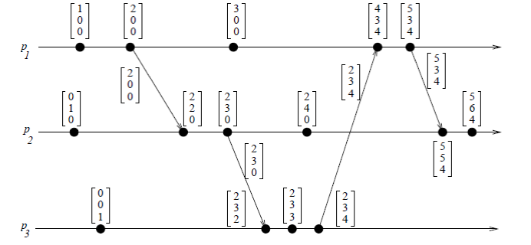
Event counting
if d is always 1 and vt_{i}[i] is the i^{th} component of vector clock at process p_{i}
then vt_{i}[i] = no. of events that have occurred at p_{i} until that instant
Vector Time – Basic Properties
Course ID: SS ZG526, Title: Distributed Computing

Slide 40
Vector Time – Basic Properties
Event counting
if an event e has timestamp vh
vh[j] = number of events executed by process p_{j} that causally precede e
Σ vh[j] −1 : total no. of events that causally precede e in the distributed computation
Course ID: SS ZG526, Title: Distributed Computing

Slide 41
Singhal–Kshemkalyani’s Differential Technique
p₁
[1 0 0 0] [2 0 0 0] [3 0 0 0]
{(1, 1)} {(1, 2)} {(1, 3)}
p₂
[2 3 1 0] [3 5 3 1] [3 6 6 3]
[1 1 0 0] [2 2 0 0] [3 4 1 0]
Processes
{(3, 1)} {(3, 3), (4, 1)} {(3, 6), (4, 3)}
p₃
[0 0 2 1] [0 0 4 2] [0 0 5 3]
[0 0 1 0] [0 0 3 1] [0 0 6 3]
{(4, 1)} {(4, 2)} {(4, 3)}
p₄
[0 0 0 1] [0 0 0 2] [0 0 0 3]
Time
Course ID: SS ZG526, Title: Distributed Computing

Slide 42
Fowler–Zwaenepoel’s Direct-Dependency Technique
reduces the size of messages by transmitting only a scalar value
process only maintains information regarding direct dependencies on other processes
transitive (indirect) dependencies are not maintained by this method
Course ID: SS ZG526, Title: Distributed Computing

Slide 43
Fowler–Zwaenepoel’s Direct-Dependency Technique
p₁
[1 0 0 0] [2 0 0 0] [3 0 0 0]
{1} {2} {3}
p₂
[2 3 1 0] [3 5 3 0] [3 6 6 0]
[1 1 0 0] [2 2 0 0] [3 4 1 0]
Processes
{1} {3} {6}
p₃
[0 0 2 1] [0 0 4 2] [0 0 5 3]
[0 0 1 0] [0 0 3 1] [0 0 6 3]
{1} {2} {3}
p₄
[0 0 0 1] [0 0 0 2] [0 0 0 3]
Time
Course ID: SS ZG526, Title: Distributed Computing

Slide 44
Reference
Ajay D. Kshemkalyani, and Mukesh Singhal, Chapter 3, “Distributed Computing: Principles, Algorithms, and Systems”, Cambridge University Press, 2008.
Course ID: SS ZG526, Title: Distributed Computing

Slide 45

Course ID: SS ZG526, Title: Distributed Computing

Slide 46
Distributed Computing A Model of Distributed Computations
Dr. Barsha Mitra
CSIS Dept, BITS Pilani, Hyderabad Campus

Slide 47
Preliminaries
distributed system consists of a set of processors
connected by a communication network
communication delay is finite but unpredictable
processors do not share a common global memory
asynchronous message passing
no common physical global clock
communication medium may deliver messages out of order
Course ID: SS ZG526, Title: Distributed Computing

Slide 48
A Distributed Program
C_{ij} : channel from process p_{i} to process p_{j}
m_{ij}: message sent by p_{i} to p_{j}
Global state of a distributed computation consists of
states of the processes
states of the communication channels
State of a process is characterized by its local memory state
Set of messages in transit in the channel characterizes state of channel
Occurrence of events
changes respective processes' states
changes channels' states
causes transition in global system state
Course ID: SS ZG526, Title: Distributed Computing

Slide 49
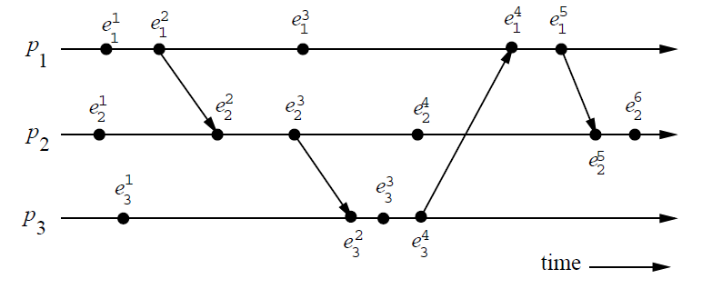
A Model of Distributed Executions
Course ID: SS ZG526, Title: Distributed Computing

Slide 50
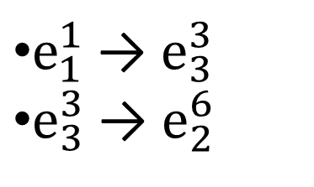
A Model of Distributed Executions
Causal Precedence/Dependency or Happens Before Relation
e_{i} → e_{j}
path
Course ID: SS ZG526, Title: Distributed Computing

Slide 51
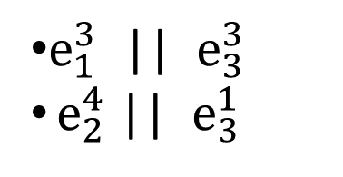
A Model of Distributed Executions
Concurrent Events
For any two events e_{i} and e_{j} , if e_{i} e_{j} and e_{j} e_{i} , then events e_{i} and e_{j} are concurrent (denoted as e_{i} || e_{j})
non-transitive
Course ID: SS ZG526, Title: Distributed Computing

Slide 52
Models of Communication Networks
FIFO model:
each channel acts as a first-in first-out message queue
message ordering is preserved by channel
Non-FIFO model
channel acts like a set
sender process adds messages to channel
receiver process removes messages from it
Course ID: SS ZG526, Title: Distributed Computing

Slide 53
Models of Communication Networks
Causal ordering model is based on Lamport’s “happens before” relation
A system supporting causal ordering model satisfies :
CO: for m_{ij} and m_{kj} , if send(m_{ij} ) → send(m_{kj} ),
then rec(m_{ij} ) → rec(m_{kj} )
Causally ordered delivery of messages implies FIFO message delivery
CO ⊂ FIFO ⊂ Non-FIFO
Course ID: SS ZG526, Title: Distributed Computing

Slide 54
Global State of a Distributed System
LS_{i}^{x}: state of process p_{i} after the occurrence of e_{i}^{x} and before e_{i}^{x+1}
SC_{ij} : state of channel C_{ij}
Consistent Global State
a state will be meaningful and consistent provided every message that is recorded as received is also recorded as sent
for all m_{ij}, send(m_{ij}) ∉ LS_{i}^{x} ⇒ m_{ij} ∉ SC_{ij} ∧ rec(m_{ij}) ∉ LS_{j}^{y}
Course ID: SS ZG526, Title: Distributed Computing

Slide 55
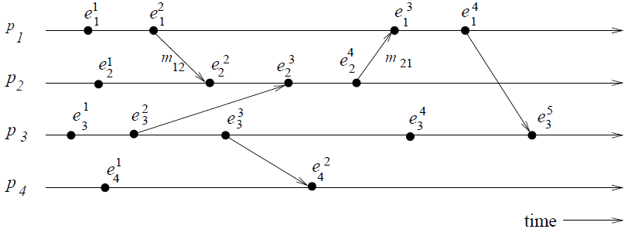
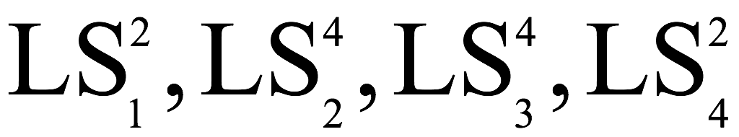
Global State of a Distributed System
GS₂ = { }
is consistent
Reason: all channels are empty except C₂₁ which contains m₂₁
Course ID: SS ZG526, Title: Distributed Computing

Slide 56
Cuts of a Distributed Computation
Zigzag line joining one arbitrary point on each process line
Set of events in distributed computation is partitioned into
PAST: contains all events to the left of the cut
FUTURE: contains all events to the right of the cut
Every cut corresponds to a global state
Every global state can be graphically represented as a cut
Course ID: SS ZG526, Title: Distributed Computing

Slide 57
Cuts of a Distributed Computation
Consistent cut: every message received in the PAST of the cut was sent in the PAST of that cut
All messages that cross the cut from the PAST to the FUTURE are in transit
Inconsistent cut: if a message crosses the cut from the FUTURE to the PAST
Course ID: SS ZG526, Title: Distributed Computing

Slide 58
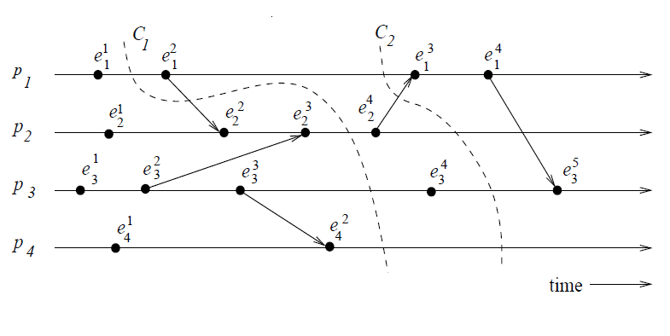
Cuts of a Distributed Computation
C₂ → consistent cut
C₁ → inconsistent cut
Course ID: SS ZG526, Title: Distributed Computing

Slide 59
Reference
Ajay D. Kshemkalyani, and Mukesh Singhal, Chapter 2, “Distributed Computing: Principles, Algorithms, and Systems”, Cambridge University Press, 2008.
Course ID: SS ZG526, Title: Distributed Computing

Slide 60
Thank You
Course ID: SS ZG526, Title: Distributed Computing

Slide 61
Distributed Computing Global State & Snapshot Recording Algorithms
Dr. Barsha Mitra
CSIS Dept, BITS Pilani, Hyderabad Campus

Slide 62
Introduction
problems in recording global state
lack of a globally shared memory
lack of a global clock
message transmission is asynchronous
message transfer delays are finite but unpredictable

Slide 63
System Model
if a snapshot recording algorithm records the states of p_{i} and p_{j} as LS_{i} and LS_{j} , respectively, it must record the state of channel C_{ij} as transit(LS_{i}, LS_{j})
For C_{ij} , intransit messages are:
transit(LS_{i}, LS_{j}) = {m_{ij} | send(m_{ij}) ∈ LS_{i} ∧ rec(m_{ij}) ∉ LS_{j}}

Slide 64
A Consistent Global State
global state GS is a consistent global state iff:
C1: every message m_{ij} that is recorded as sent in the local state of sender p_{i} must be captured either in the state of C_{ij} or in the collected local state of the receiver p_{j}
C1 states the law of conservation of messages:
C2: send(m_{ij}) ∉LS_{i} ⇒ m_{ij} ∉ SC_{ij} ∧ rec(m_{ij}) ∉ LS_{j}
Condition C2 states that for every effect, its cause must be present

Slide 65
Chandy–Lamport Algorithm
Marker sending rule for process p_{i}
(1) Process p_{i} records its state.
(2) For each outgoing channel C on which a marker has not been sent, p_{i} sends a marker along C before p_{i} sends further messages along C.
Marker receiving rule for process p_{j}
On receiving a marker along channel C:
if p_{j} has not recorded its state then
Record the state of C as the empty set
Execute the “marker sending rule”
else
Record the state of C as the set of messages received along C after p_{j’s}
state was recorded and before p_{j} received the marker along C

Slide 66
Chandy–Lamport Algorithm
Putting together recorded snapshots - each process can send its local snapshot to the initiator of the algorithm
termination criterion - each process has received a marker on all of its incoming channels

Slide 67
500 450 450 350 370 370
S1: A
Chandy–Lamport Algorithm
100
50
20
S2: B
1000 1000 1050 1030 1130 1130
t₀ t₁ t₂ t₃ t₄ t₅

Slide 68
Snapshot Algorithms for Non-FIFO Channels
a marker cannot be used to
non-FIFO algorithm by Lai and Yang use message piggybacking to distinguish computation messages sent after the marker from those sent before the marker

Slide 69
Lai–Yang Algorithm
coloring scheme
every process is initially white
process turns red while taking a snapshot
equivalent of the “marker sending rule” is executed when a process turns red
every message sent by a white process is colored white
a white message is a message that was sent before the sender of that message recorded its local snapshot

Slide 70
Lai–Yang Algorithm
every message sent by a red process is colored red
a red message is a message that was sent after the sender of that message recorded its local snapshot
every white process takes its snapshot no later than the instant it receives a red message
when a white process receives a red message, it records its local snapshot before processing the message

Slide 71
Lai–Yang Algorithm
every white process records a history of all white messages sent or received by it along each channel
when a process turns red, it sends these histories along with its snapshot to the initiator process that collects the global snapshot
initiator process evaluates transit(LS_{i}, LS_{j}) to compute the state of a channel C_{ij} as:
SC_{ij} = {white messages sent by p_{i} on C_{ij}} − {white messages received by p_{j} on C_{ij}}
= {m_{ij} | send(m_{ij}) ∈ LS_{i}} − {m_{ij} | rec(m_{ij}) ∈ LS_{j}}

Slide 72
800 780 750 740 740 740 770 770 790
P1: X
10
30
Lai–Yang Algorithm
20
20
30
P2: Y
200 200 220 220 190 200 230 210
t₁ t₂ t₃ t₄ t₅ t₆ t₇ t₈ t₉
SC₁₂ = {white messages sent by P1 on C₁₂} – {white messages received by P2 on C₁₂}
SC₂₁ = {white messages sent by P2 on C₂₁} – {white messages received by P1 on C₂₁}

Slide 73
Reference
Ajay D. Kshemkalyani, and Mukesh Singhal, Chapter 4, “Distributed Computing: Principles, Algorithms, and Systems”, Cambridge University Press, 2008.

Slide 74
Thank You

Slide 75
Message ordering
Dr. Barsha Mitra
CSIS Dept, BITS Pilani, Hyderabad Campus

Slide 76
Group Communication
broadcast - sending a message to all members in the distributed system
multicasting - a message is sent to a certain subset, identified as a group, of the processes in the system
unicasting - point-to-point message communication

Slide 77
Causal Order
A system supporting causal ordering model satisfies
CO: for m_{ij} and m_{kj} , if send(m_{ij} ) → send(m_{kj} ),
then rec(m_{ij} ) → rec(m_{kj} )
2 criteria must be satisfied by a causal ordering protocol:
Safety
Liveness

Slide 78
Causal Order
Safety
a message M arriving at a process may need to be buffered until all system-wide messages sent in the causal past of the send(M) event to the same destination have already arrived
distinction is made between
arrival of a message at a process
event at which the message is given to the application process
Liveness
A message that arrives at a process must eventually be delivered to the process

Slide 79
Raynal–Schiper–Toueg Algorithm
each message M should carry a log of
all other messages
sent causally before M’s send event, and sent to the same destination dest(M)
log can be examined to ensure whether it is safe to deliver a message
channels are FIFO

Slide 80
Raynal–Schiper–Toueg Algorithm
local variables:
array of int SENT[1 …… n, 1 …… n] (n x n array)
SENT_{i}[j, k] = no. of messages sent by P_{j} to P_{k} as known to P_{i}
array of int DELIV [1 …… n]
DELIV_{i}[j] = no. of messages from P_{j} that have been delivered to P_{i}
(1) send event, where P_{i} wants to send message M to P_{j} :
(1a) send (M, SENT) to P_{j}
(1b) SENT[i, j] = SENT[i, j] + 1

Slide 81
Raynal–Schiper–Toueg Algorithm
(2) message arrival, when (M, ST) arrives at P_{i} from P_{j} :
(2a) deliver M to P_{i} when for each process x,
(2b) DELIV_{i}[x] ≥ ST[x, i ]
(2c) ∀ x, y, SENT[x, y] = max(SENT[x, y], ST[x, y])
(2d) DELIV_{i}[j] = DELIV_{i}[j] + 1

Slide 82
Raynal–Schiper–Toueg Algorithm
Complexity:
space requirement at each process: O(n²) integers
space overhead per message: n² integers
time complexity at each process for each send and deliver event: O(n²)

Slide 83
Raynal–Schiper–Toueg Algorithm
P₁ sent 3 messages to P₂
P₁ sent 4 messages to P₃
P₂ sent 5 messages to P₁
P₂ sent 2 messages to P₃
P₃ sent 4 messages to P₂
Now if,
P₁ sends m₁ to P₂
SENT of P₁
Updated SENT of P₁
0 | 3 | 4
5 | 0 | 2
0 | 4 | 0
0 | 4 | 4
5 | 0 | 2
0 | 4 | 0
DELIV₁ = [0 4 0]
DELIV₂ = [3 0 4]
DELIV₃ = [3 2 0]
SENT of P₂
0 | 3 | 4
5 | 0 | 2
0 | 4 | 0

Slide 84
Raynal–Schiper–Toueg Algorithm
P₁ sent 3 messages to P₂
P₁ sent 4 messages to P₃
P₂ sent 5 messages to P₁
P₂ sent 2 messages to P₃
P₃ sent 4 messages to P₂
Now if,
P₃ sends m₂ to P₂
SENT of P₃
Updated SENT of P₃
0 | 3 | 4
5 | 0 | 2
0 | 4 | 0
0 | 3 | 4
5 | 0 | 2
0 | 5 | 0
DELIV₁ = [0 4 0]
DELIV₂ = [4 0 4]
DELIV₃ = [3 2 0]
SENT of P₂
0 | 3 | 4
5 | 0 | 2
0 | 4 | 0

Slide 85
Raynal–Schiper–Toueg Algorithm
P₁ sent 3 messages to P₂
P₁ sent 4 messages to P₃
P₂ sent 5 messages to P₁
P₂ sent 2 messages to P₃
P₃ sent 4 messages to P₂
Now if,
P₁ sends m₃ to P₃
SENT of P₁
Updated SENT of P₁
0 | 4 | 4
5 | 0 | 2
0 | 4 | 0
0 | 4 | 5
5 | 0 | 2
0 | 4 | 0
DELIV₁ = [0 4 0]
DELIV₂ = [4 0 5]
DELIV₃ = [3 2 0]
SENT of P₃
0 | 3 | 4
5 | 0 | 2
0 | 5 | 0

Slide 86
Birman-Schiper-Stephenson Protocol
C_{i} = vector clock of P_{i}
C_{i}[j] = j^{th} element of C_{i}
tm = vector timestamp for message m
P_{i} sends a message m to P_{j}
P_{i} increments C_{i}[i]
P_{i} sets the timestamp tm = C_{i} for message m

Slide 87
Birman-Schiper-Stephenson Protocol
P_{j} receives a message m from P_{i}
when P_{j} (j ≠ i) receives m with timestamp tm, it delays message delivery until:
C_{j}[i] = tm[i] - 1 //P_{j} has received all preceeding messages sent by P_{i}
∀ k <= n and k ≠ i, C_{j}[k] ≥ tm[k] //P_{j} has received all the messages that were received at P_{i} from other processes before P_{i} sent m
when m is delivered to P_{j}, update P_{j}'s vector clock
∀i, C_{j}[i] = max(C_{j}[i], tm[i])
check buffered messages to see if any can be delivered

Slide 88






Birman-Schiper-Stephenson Protocol
P1
$$\left[0 0 0\right]$$
$$\left[0 0 1\right]$$
vectors in blue indicate timestamps of messages
P2
$$\left[0 0 0\right]$$
$$\left[0 0 1\right]$$
P3
$$\left[0 0 0\right]$$
$$\left[0 0 1\right]$$

Slide 89





Birman-Schiper-Stephenson Protocol
$$\left[0 0 0\right]$$
P1
$$\left[0 0 1\right]$$
P2
$$\left[0 0 1\right]$$
$$\left[0 0 0\right]$$
$$\left[0 0 1\right]$$
P3
$$\left[0 0 0\right]$$
$$\left[0 0 1\right]$$

Slide 90






Birman-Schiper-Stephenson Protocol
P1
$$\left[0 0 0\right]$$
$$\left[0 1 1\right]$$
$$\left[0 0 1\right]$$
vectors in red indicate timestamps of messages
P2
$$\left[0 0 1\right]$$
$$\left[0 1 1\right]$$
$$\left[0 0 0\right]$$
$$\left[0 0 1\right]$$
$$\left[0 1 1\right]$$
P3
$$\left[0 0 0\right]$$
$$\left[0 0 1\right]$$
$$\left[0 1 1\right]$$

Slide 91

Birman-Schiper-Stephenson Protocol
P1
(buffer)
$$\left[0 0 1\right]$$
$$\left[0 0 0\right]$$
$$\left[0 1 1\right]$$
$$\left[0 0 1\right]$$
P2
$$\left[0 0 1\right]$$
$$\left[0 1 1\right]$$
$$\left[0 0 0\right]$$
$$\left[0 0 1\right]$$
$$\left[0 1 1\right]$$
P3
$$\left[0 0 0\right]$$
$$\left[0 0 1\right]$$
$$\left[0 1 1\right]$$

Slide 92

Birman-Schiper-Stephenson Protocol
P1
(buffer)
$$\left[0 0 1\right]$$
$$\left[0 1 1\right]$$
$$\left[0 0 0\right]$$
$$\left[0 1 1\right]$$
deliver
from buffer
$$\left[0 0 1\right]$$
SES Protocol from Recorded Lecture
P2
$$\left[0 0 1\right]$$
$$\left[0 1 1\right]$$
$$\left[0 0 0\right]$$
$$\left[0 0 1\right]$$
$$\left[0 1 1\right]$$
P3
$$\left[0 0 0\right]$$
$$\left[0 0 1\right]$$
$$\left[0 1 1\right]$$

Slide 93
References
Ajay D. Kshemkalyani, and Mukesh Singhal, Chapter 6, “Distributed Computing: Principles, Algorithms, and Systems”, Cambridge University Press, 2008.
Ajay D. Kshemkalyani, and Mukesh Singhal, Chapter 7, “Distributed Computing: Principles, Algorithms, and Systems”, Cambridge University Press, 2008.
https://courses.csail.mit.edu/6.006/fall11/rec/rec14.pdf

Slide 94
Thank You

Slide 95
Distributed Computing Terminology & Basic Algorithms
Dr. Barsha Mitra
CSIS Dept, BITS Pilani, Hyderabad Campus

Slide 96
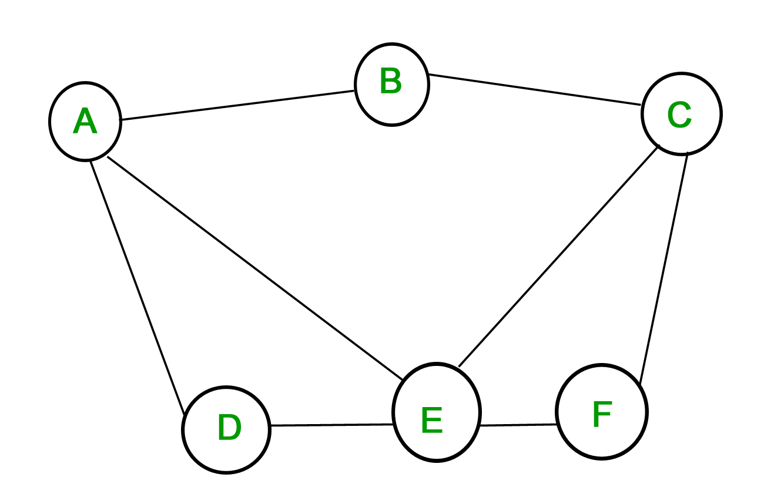
Notation & Definitions
undirected unweighted graph G = (N, L) represents topology
vertices are nodes
edges are channels
n = |N|
l = |L|
diameter of a graph –
minimum number of edges that need to be traversed to go from any node to any other node
diameter = max_{i, j ∈ N} {length of the shortest path between i and j}
A, B → 1 A, C → 2
A, D → 1 A, F → 2
A, E → 1 B, D → 2
B, C → 1 B, E → 2
C, E → 1 B, F → 2
C, F → 1 C, D → 2
D, E → 1 D, F → 2
E, F → 1

Slide 97
Synchronous Single-Initiator Spanning Tree Algorithm using Flooding
algorithm proceeds in rounds (synchronous)
root initiates the algorithm
flooding of QUERY messages
produce a spanning tree rooted at the root node
each process P_{i} (P_{i} ≠ root) should output its own parent for the spanning tree

Slide 98
Synchronous Single-Initiator Spanning Tree Algorithm using Flooding
Local Variables maintained at each P_{i}
int visited
int depth
int parent
set of int Neighbors
Initially at each P_{i}
visited = 0
depth = 0
parent = NULL
Neighbors = set of neighbors

Slide 99
Synchronous Single-Initiator Spanning Tree Algorithm using Flooding
Algorithm for P_{i}
Round r = 1
if P_{i} = root then
visited = 1
depth = 0
send QUERY to Neighbors
if P_{i} receives a QUERY message then
visited = 1
depth = r
parent = root
plan to send QUERYs to Neighbors at next round

Slide 100
Synchronous Single-Initiator Spanning Tree Algorithm using Flooding
Algorithm for P_{i}
Round r > 1 and r <= diameter
if P_{i} planned to send in previous round then
P_{i} sends QUERY to Neighbors
if visited = 0 then
if P_{i} receives QUERY messages then
visited = 1
depth = r
parent = any randomly selected node from which QUERY was received
plan to send QUERY to Neighbors \ {senders of QUERYs received in r}

Slide 101
Synchronous Single-Initiator Spanning Tree Algorithm using Flooding
A
(1)
B
C
QUERY
(1)
F
E
D

Slide 102
Synchronous Single-Initiator Spanning Tree Algorithm using Flooding
A
(1)
B
C
QUERY
(1)
F
E
D

Slide 103
Synchronous Single-Initiator Spanning Tree Algorithm using Flooding
A
B
(2)
C
QUERY
(2)
F
(2)
E
D

Slide 104
Synchronous Single-Initiator Spanning Tree Algorithm using Flooding
A
B
(2)
C
QUERY
(2)
F
(2)
E
D

Slide 105
Synchronous Single-Initiator Spanning Tree Algorithm using Flooding
A
B
C
(3)
QUERY
(3)
(3)
F
E
(3)
D

Slide 106
Synchronous Single-Initiator Spanning Tree Algorithm using Flooding
A
B
C
(3)
QUERY
(3)
(3)
F
E
(3)
D

Slide 107
Synchronous Single-Initiator Spanning Tree Algorithm using Flooding
A
B
C
F
E
D

Slide 108
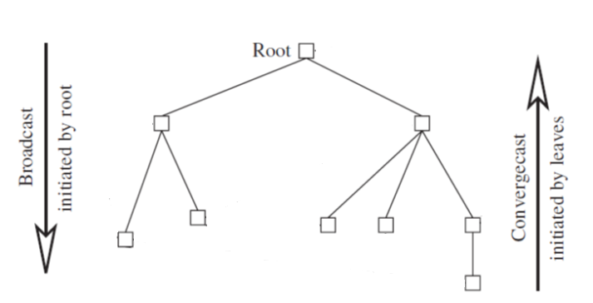
Broadcast and Convergecast on a Tree
A spanning tree is useful for distributing (via a broadcast) and collecting (via a convergecast) information to/from all the nodes
Broadcast Algorithm:
BC1:
The root sends the information to be broadcast to all its children.
BC2:
When a (non-root) node receives information from its parent, it copies it and forwards it to its children.

Slide 109
Broadcast and Convergecast on a Tree
Convergecast Algorithm:
CVC1:
Leaf node sends its report to its parent.
CVC2:
At a non-leaf node that is not the root: When a report is received from all the child nodes, the collective report is sent to the parent.
CVC3:
At the root: When a report is received from all the child nodes, the global function is evaluated using the reports.

Slide 110
Broadcast and Convergecast on a Tree
Complexity
each broadcast and each convergecast requires n − 1 messages
each broadcast and each convergecast requires time equal to the maximum height h of the tree, which is O(n)

Slide 111
Reference
Ajay D. Kshemkalyani, and Mukesh Singhal, Chapter 5, “Distributed Computing: Principles, Algorithms, and Systems”, Cambridge University Press, 2008.

Slide 112
Thank You

Slide 113
Distributed Mutual Exclusion
Dr. Barsha Mitra
CSIS Dept, BITS Pilani, Hyderabad Campus

Slide 114
Types of Approaches
Token-based
Assertion-based
From Recorded Lecture
Quorum-based

Slide 115
Quorum-Based Approach
each site requests permission to execute the CS from a subset of sites called quorum
quorums are formed in such a way that when two sites concurrently request access to the CS
at least one site receives both the requests
this site is responsible to make sure that only one request executes the CS at any time

Slide 116
Requirements of Mutual Exclusion Algorithms
Safety property
at any instant, only one process can execute the CS
Liveness property
a site must not wait indefinitely to execute the CS while other sites are repeatedly executing the CS
Fairness
each process gets a fair chance to execute the CS
CS execution requests are executed in order of their arrival time
time is determined by a logical clock

Slide 117
Performance Metrics
From Recorded Lecture

Slide 118
Lamport’s Algorithm
every site S_{i} keeps a queue, request_queue_{i}
request_queue_{i} contains mutual exclusion requests ordered by their timestamps
FIFO
CS requests are executed in increasing order of timestamps

Slide 119
Lamport’s Algorithm
Requesting the critical section:
• When a site S_{i} wants to enter the CS, it broadcasts a REQUEST(ts_{i}, i) message to all other sites and places the request on request_queue_{i}. ((ts_{i}, i) denotes the timestamp of the request)
• When a site S_{j} receives the REQUEST(ts_{i}, i) message from site S_{i}, it places site S_{i}’s request on request_queue_{j} and returns a timestamped REPLY message to S_{i}

Slide 120
Lamport’s Algorithm
Executing the critical section:
Site S_{i} enters the CS when the following two conditions hold:
L1: S_{i} has received a REPLY message with timestamp larger than (ts_{i}, i) from all other sites
L2: S_{i}’s request is at the top of request_queue_{i}
Releasing the critical section:
• Site S_{i}, upon exiting the CS, removes its request from the top of its request queue and broadcasts a timestamped RELEASE message to all other sites
• When a site S_{j} receives a RELEASE message from site S_{i}, it removes S_{i}’s
request from its request queue

Slide 121
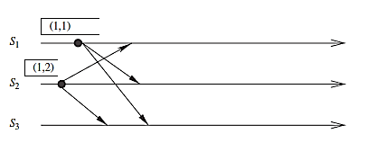
Lamport’s Algorithm
Sites S₁ and S₂ make requests for the CS

Slide 122
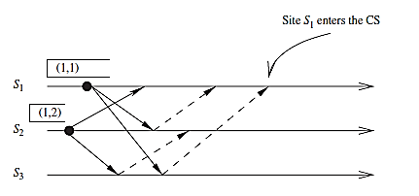


Lamport’s Algorithm
REPLY
May also write as: request_queue₁ = ((1, 1), (1, 2))
REQUEST
Site S₁ enters the CS

Slide 123
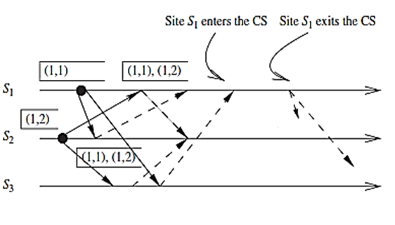
Lamport’s Algorithm
RELEASE
Site S₁ exits the CS and sends RELEASE messages

Slide 124
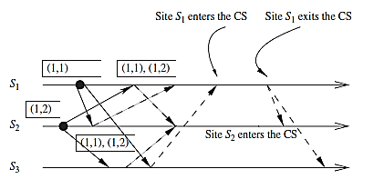

Lamport’s Algorithm
Site S₂ enters the CS
Performance - Requires 3(N − 1) messages per CS invocation

Slide 125
Ricart–Agrawala Algorithm
communication channels are not required to be FIFO
REQUEST and REPLY messages
each process p_{i} maintains the request-deferred array, RD_{i}
size of RD_{i} = no. of processes in the system
initially, ∀i ∀j: RD_{i}[j] = 0
whenever p_{i} defers the request sent by p_{j}, it sets RD_{i}[j] = 1,
after it has sent a REPLY message to p_{j} , it sets RD_{i}[j] = 0

Slide 126
Ricart–Agrawala Algorithm
Requesting the critical section:
When a site S_{i} wants to enter the CS, it broadcasts a timestamped REQUEST message to all other sites
(b) When site S_{j} receives a REQUEST message from site S_{i}, it sends a REPLY message to site S_{i} if site S_{j} is neither requesting nor executing the CS, or if the site S_{j} is requesting and S_{i}’s request’s timestamp is smaller than site S_{j}’s own request’s timestamp. Otherwise, the reply is deferred and S_{j} sets RD_{j} [i] = 1

Slide 127
Ricart–Agrawala Algorithm
Executing the critical section:
(c) Site S_{i} enters the CS after it has received a REPLY message from every site it sent a REQUEST message to
Releasing the critical section:
(d) When site S_{i} exits the CS, it sends all the deferred REPLY messages:
∀j if RD_{i} [j] = 1, then S_{i} sends a REPLY message to S_{j} and sets RD_{i} [j] = 0

Slide 128
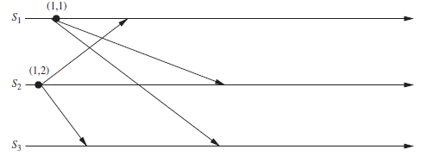
Ricart–Agrawala Algorithm
Sites S₁ and S₂ each make a request for the CS

Slide 129
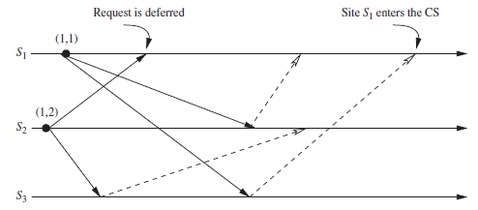
Ricart–Agrawala Algorithm
Site S₁ enters the CS

Slide 130
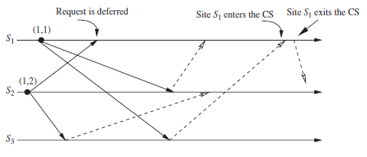
Ricart–Agrawala Algorithm
Site S₁ exits the CS and sends a REPLY message to S₂’s deferred request

Slide 131
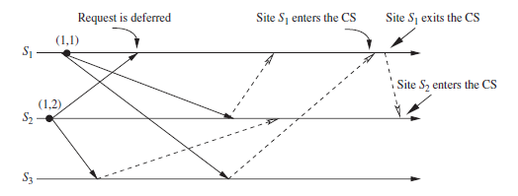
Ricart–Agrawala Algorithm
Site S₂ enters the CS
Performance - requires 2(N − 1) messages per CS execution

Slide 132
Maekawa’s Algorithm
quorum-based mutual exclusion algorithm
request sets for sites (i.e., quorums) are constructed to satisfy the following conditions:
M1: (∀i ∀j : i ≠ j, 1 ≤ i, j ≤ N :: R_{i} ∩ R_{j} ≠ φ )
M2: (∀i : 1 ≤ i ≤ N :: S_{i} ∈ R_{i})
M3: (∀i : 1 ≤ i ≤ N :: |R_{i}| = K for some K)
M4: Any site S_{j} is contained in K number of R_{i}’s, 1 ≤ i, j ≤ N
Maekawa showed that N = K(K − 1) + 1
This relation gives |R_{i}| = K = √N (square root of N)
Uses REQUEST, REPLY and RELEASE messages
Performance → 3√N messages per CS invocation

Slide 133
Maekawa’s Algorithm: Problem

Slide 134
Maekawa’s Algorithm
Algorithm Steps: from Recorded Lecture
Deadlocks: from Recorded Lecture

Slide 135
Raymond’s Tree-Based Algorithm
uses a spanning tree of the network
each node maintains a HOLDER variable that provides information about the placement of the privilege in relation to the node itself
a node stores in its HOLDER variable the identity of a node that it thinks has the privilege or leads to the node having the privilege
for 2 nodes X and Y, if HOLDER_{X} = Y, the undirected edge between X and Y can be redrawn as a directed edge from X to Y
Node containing the privilege is also known as the root node

Slide 136
Raymond’s Tree-Based Algorithm
messages between nodes traverse along undirected edges of the tree
node needs to hold information about and communicate only to its immediate-neighboring nodes
HOLDER_{N1} = N2
HOLDER_{N2} = N3
HOLDER_{N3} = self
HOLDER_{N4} = N3
HOLDER_{N5} = N4
HOLDER_{N6} = N5
HOLDER_{N7} = N5
HOLDER_{N8} = N6
HOLDER_{N9} = N6
N1
N2
N3
N4
N9
N6
N5
N8
N7

Slide 137
N1
N2
N3
N4
N1
N2
N3
N4
N9
N6
N5
N9
N6
N5
Raymond’s Tree-Based Algorithm
N8
N7
N8
N7

Slide 138
Raymond’s Tree-Based Algorithm
Data Structures
HOLDER
USING
possible values true or false
indicates if the current node is executing the critical section
ASKED
possible values true or false
indicates if node has sent a request for the privilege
prevents the sending of duplicate requests for privilege

Slide 139
Raymond’s Tree-Based Algorithm
Data Structures
REQUEST_Q
FIFO queue that can contain “self ” or the identities of immediate neighbors as elements
REQUEST_Q of a node consists of the identities of those immediate neighbors that have requested for privilege but have not yet been sent the privilege
maximum size of REQUEST_Q of a node is the number of immediate neighbors + 1 (for “self ”)

Slide 140
Suzuki–Kasami’s Broadcast Algorithm
broadcasts a REQUEST message for the token to all other sites
site that possesses the token sends it to the requesting site upon the receipt of its REQUEST message
if a site receives a REQUEST message when it is executing the CS, it sends the token only after it has completed the CS execution

Slide 141
Suzuki–Kasami’s Broadcast Algorithm
Distinguish outdated and current REQUEST messages
REQUEST(j, sn) where sn (sn = 1, 2…..) is a sequence number that indicates that S_{j} is requesting its sn^{th} CS execution
S_{i} keeps an array of integers RN_{i}[1, … ,n] where RN_{i}[j] is the largest sequence number received in a REQUEST message so far from S_{j}
when S_{i} receives a REQUEST(j, sn) message, it sets RN_{i}[j] = max(RN_{i}[j], sn)
when S_{i} receives a REQUEST(j,sn) message, the request is outdated if RN_{i}[j] > sn

Slide 142
Suzuki–Kasami’s Broadcast Algorithm
sites with outstanding requests for the CS are determined in the following manner:
token consists of a queue of requesting sites, Q, and an array of integers LN[1, … ,n], where LN[j] is the sequence number of the request which S_{j} executed most recently
after executing its CS, a S_{i} updates LN[i] = RN_{i}[i]
token array LN[1, … ,n] permits a site to determine if a site has an outstanding request for the CS
at S_{i}, if RN_{i}[j] = LN[j] + 1, then S_{j} is currently requesting a token
after executing the CS, a site checks this condition for all the j’s to determine all the sites that are requesting the token and places their i.d.’s in queue Q if these i.d.’s are not already present in Q
finally, the site sends the token to the site whose i.d. is at the head of Q

Slide 143
Suzuki–Kasami’s Broadcast Algorithm
Requesting the critical section:
(a) If requesting site S_{i} does not have the token, then it increments its sequence number, RN_{i}[i], and sends a REQUEST(i, sn) message to all other sites. (“sn” is the updated value of RN_{i}[i].)
(b) When a site S_{j} receives this message, it sets RN_{j}[i] to max(RN_{j}[i], sn). If S_{j} has the idle token, then it sends the token to S_{i} if RN_{j}[i] = LN[i]+1.
Executing the critical section:
(c) Site S_{i} executes the CS after it has received the token.

Slide 144
Suzuki–Kasami’s Broadcast Algorithm
Releasing the critical section: Having finished the execution of the CS, site S_{i} takes the following actions:
(d) It sets LN[i] element of the token array equal to RN_{i}[i].
(e) For every site S_{j} whose i.d. is not in the token queue, it appends its i.d. to the token queue if RN_{i}[j] = LN[j] + 1.
(f) If the token queue is non-empty after the above update, S_{i} deletes the top site i.d. from the token queue and sends the token to the site indicated by the i.d.

Slide 145
Suzuki–Kasami’s Broadcast Algorithm
Performance
if a site holds the token, no message is required
if a site does not hold the token, N messages are required

Slide 146
Reference
Ajay D. Kshemkalyani, and Mukesh Singhal, Chapter 9, “Distributed Computing: Principles, Algorithms, and Systems”, Cambridge University Press, 2008.

Slide 147
Thank You

